Slide 1
Innovation and collaboration
BIM Kongress 2018

Slide 2
Why to collaborate?

Slide 3
Digitalisation
Blurring the lines between the physical, digital and biological spheres
4th Industrial Revolution
21st century
Digitalization
3rd Industrial Revolution
20th century (1969)
Information technology
2nd Industrial Revolution
1 1 0 1 0 1 0 1 1 1 0
0 1 0 1 0 0 1 1 0 0
1 0 0 1 0 0 0 0 1
0 1 1 0 0 0 1 1
0 1 1 1 1 0
19th century (1870)
Electricity
1st Industrial Revolution
18th century (1784)
Steam

Slide 4

Switzerland is always online!
About 7 years ago, less than 10% of the population were using smartphones!
11%
use a wearable fitness tracker
13:00
6%
use a smartwatch
Average amount of time spent on devices per day
31%
use a smart TV
8 hrs
48 mins
90%
8 hrs
48 mins
use a smartphone
Reference: Ernst & young - Digital Nations –
State of Switzerland 2016 - 2017

Slide 5
Relevant & urgency
Major changes to happen in our economy within 4 years!
Increase of digital revenues of large organizations is expected by 2020
80%
Customers will shop in augmented reality by 2020
100M
of enterprises will launch advanced digital transformation initiatives by 2020
50%
Reference: Gartner

Slide 6
We are all involved in this process
Is there any industry which is not in transformation so far?
Digital Transformation is important to all Industries
All industries believe digital transformation is important to their future success, yet many are still failing to act.
Healthcare Payers
74%
Financial Services
70%
Life Sciences
64%
Manufacturing
62%
Insurance
61%
Healtcare Providers
60%
Retail (stores, supermarkets)
57%
0%
100%
Reference: Cognizant Center for the Future of Work, 2016 | Response base: 2000 global executives

Slide 7
of revenues will be at risk due to shifting consumers‘ spending after 2018
50%
of kids today will do jobs that haven‘t been invented yet
65%

Slide 8
What about digitalswitzerland?

Slide 9
Making Switzerland a Leading Digital Innovation Hub. Worldwide!

Slide 10















Our Impact drivers!
Politico-economic Environment
digitalshapers
Education, Talent, Research
Top Talent Studie
ADAPT
Video School Contest
Start-up Enablement
Corporate Enablement & Services
inspirationalsessions
digitalgipfel
WEFbreakfast
Public Dialogue & Events
International Visibility &
Connectivity
DeepTechSwitzerland

Slide 11
Concrete examples for collaboration

Slide 13
Decentralised clusters
„Magic Underlying“ in Switzerland: Decentralized clusters are currently ramping up
Robotics
Data & AI
DigitalHealth
Digital Sports
B2B Software
Advanced Manufacturing
MedTech
CleanTech
Robotics
VR, AI
Blockchain
eTourism
eTourism
Digitale Infrastructure
Blockchain
Humanitary
eTourism
eHealth
FashionTech
Main Clusters around ETHZ & EPFL
Decentralized Clusters

Slide 14
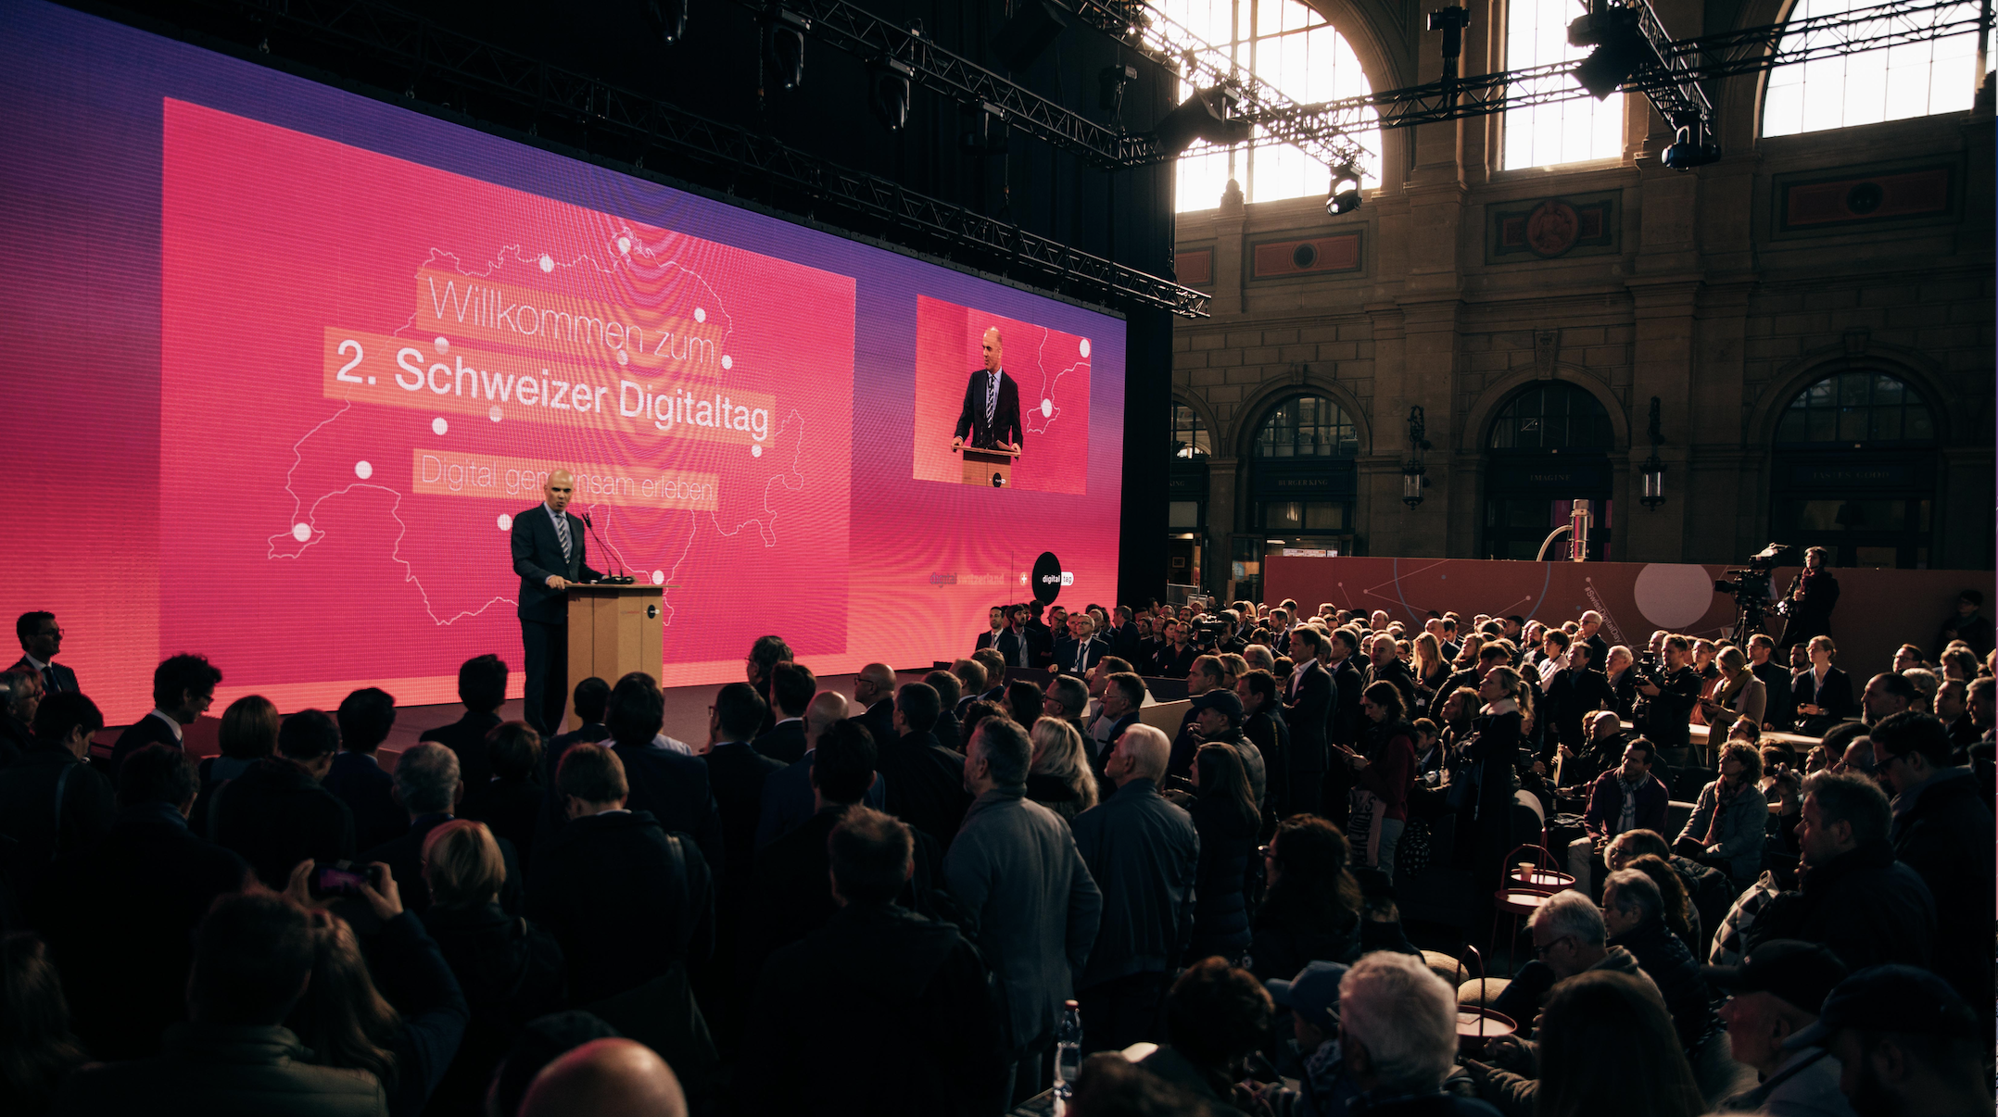

Slide 15
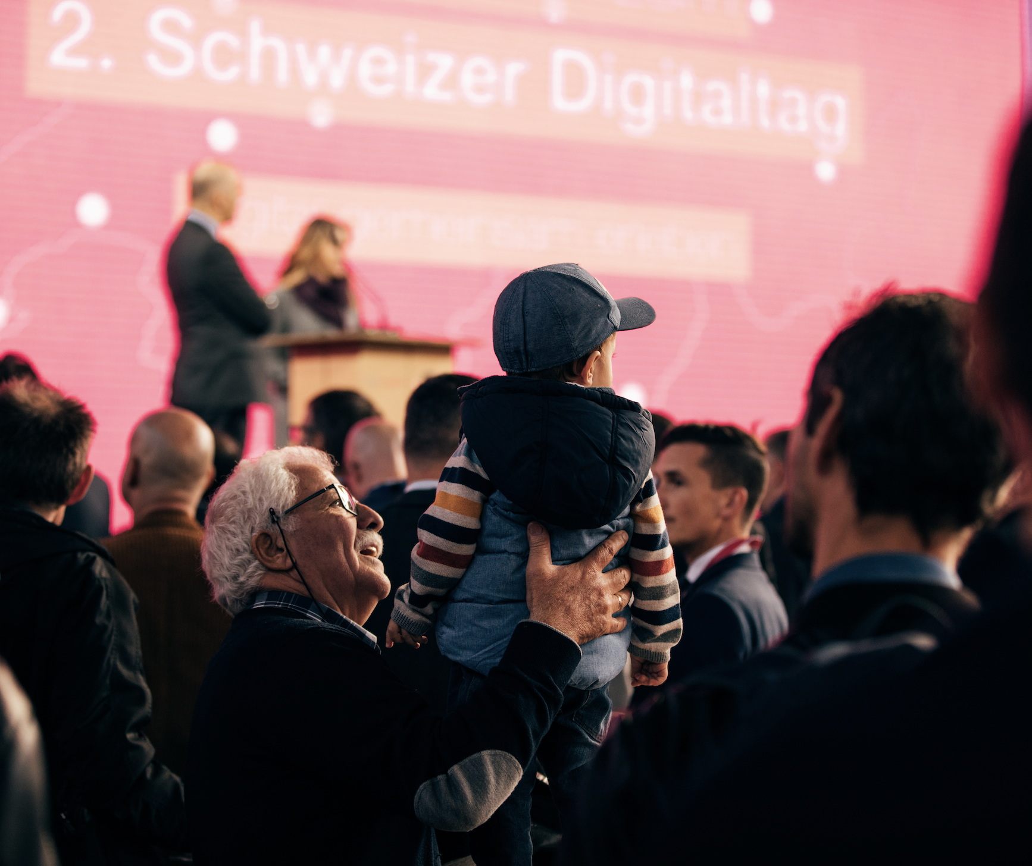
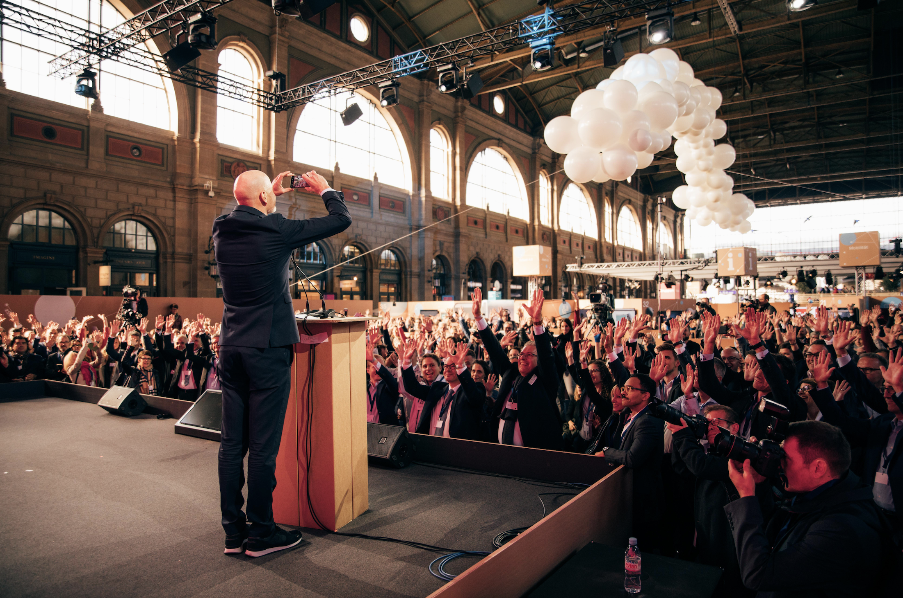
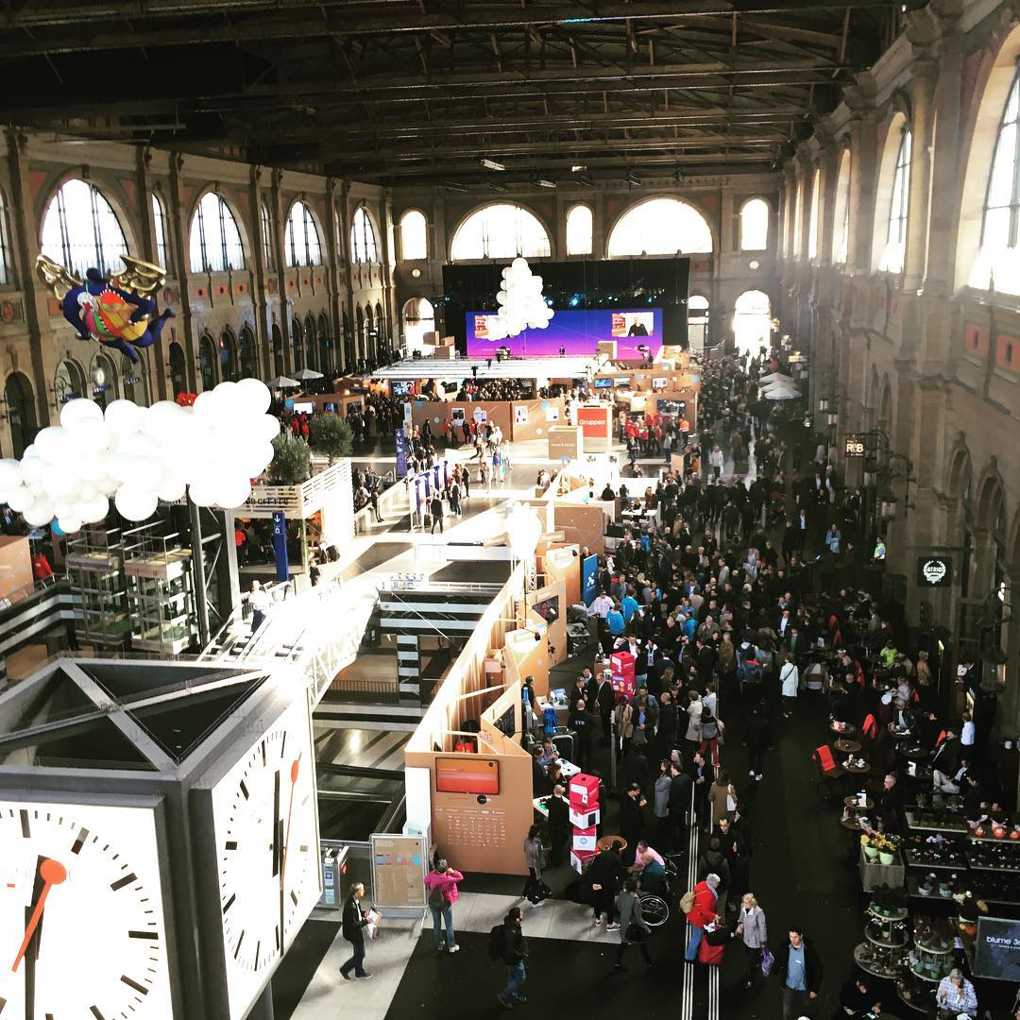
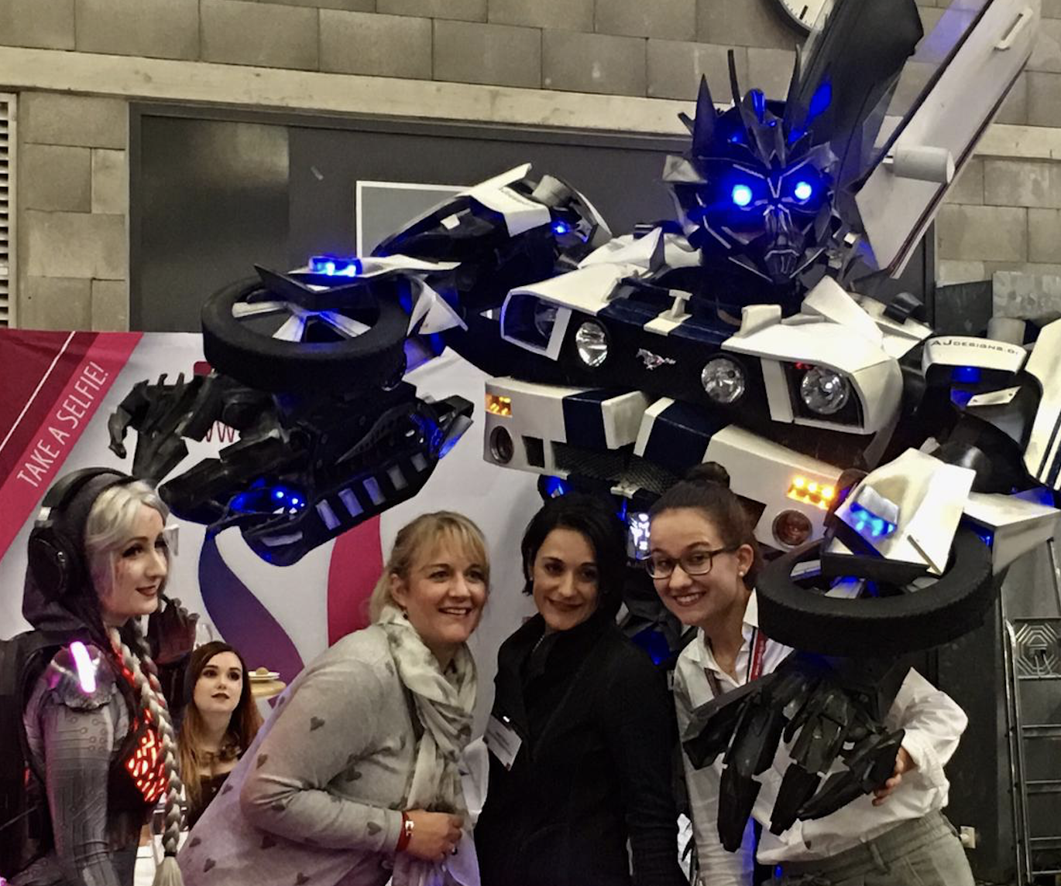
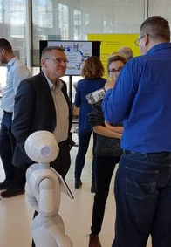
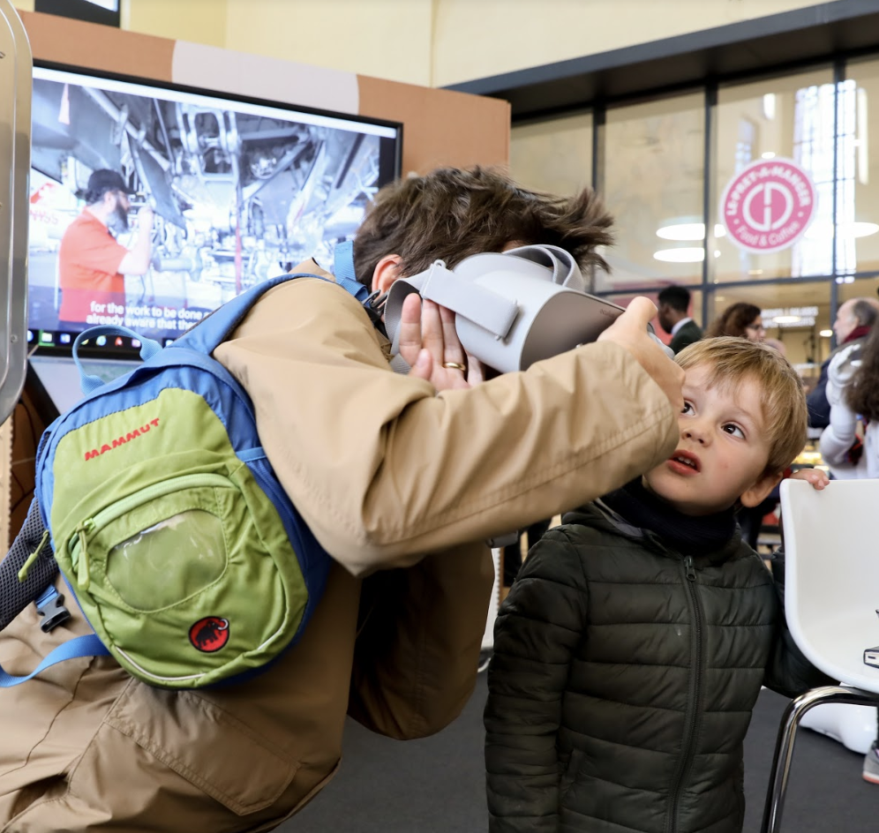

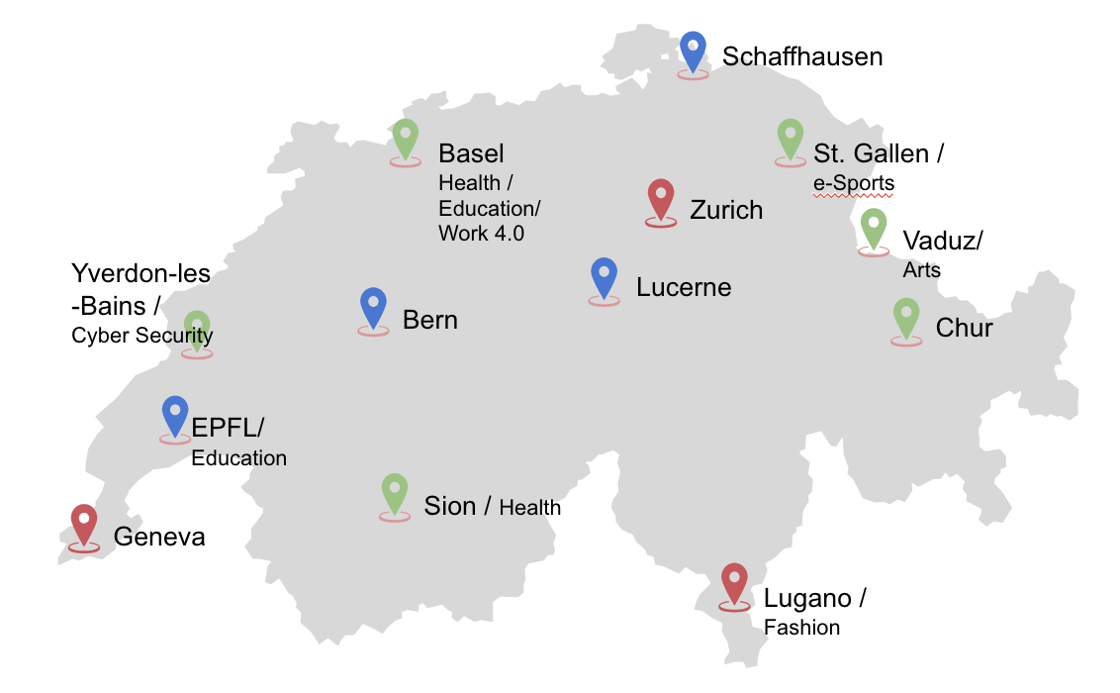
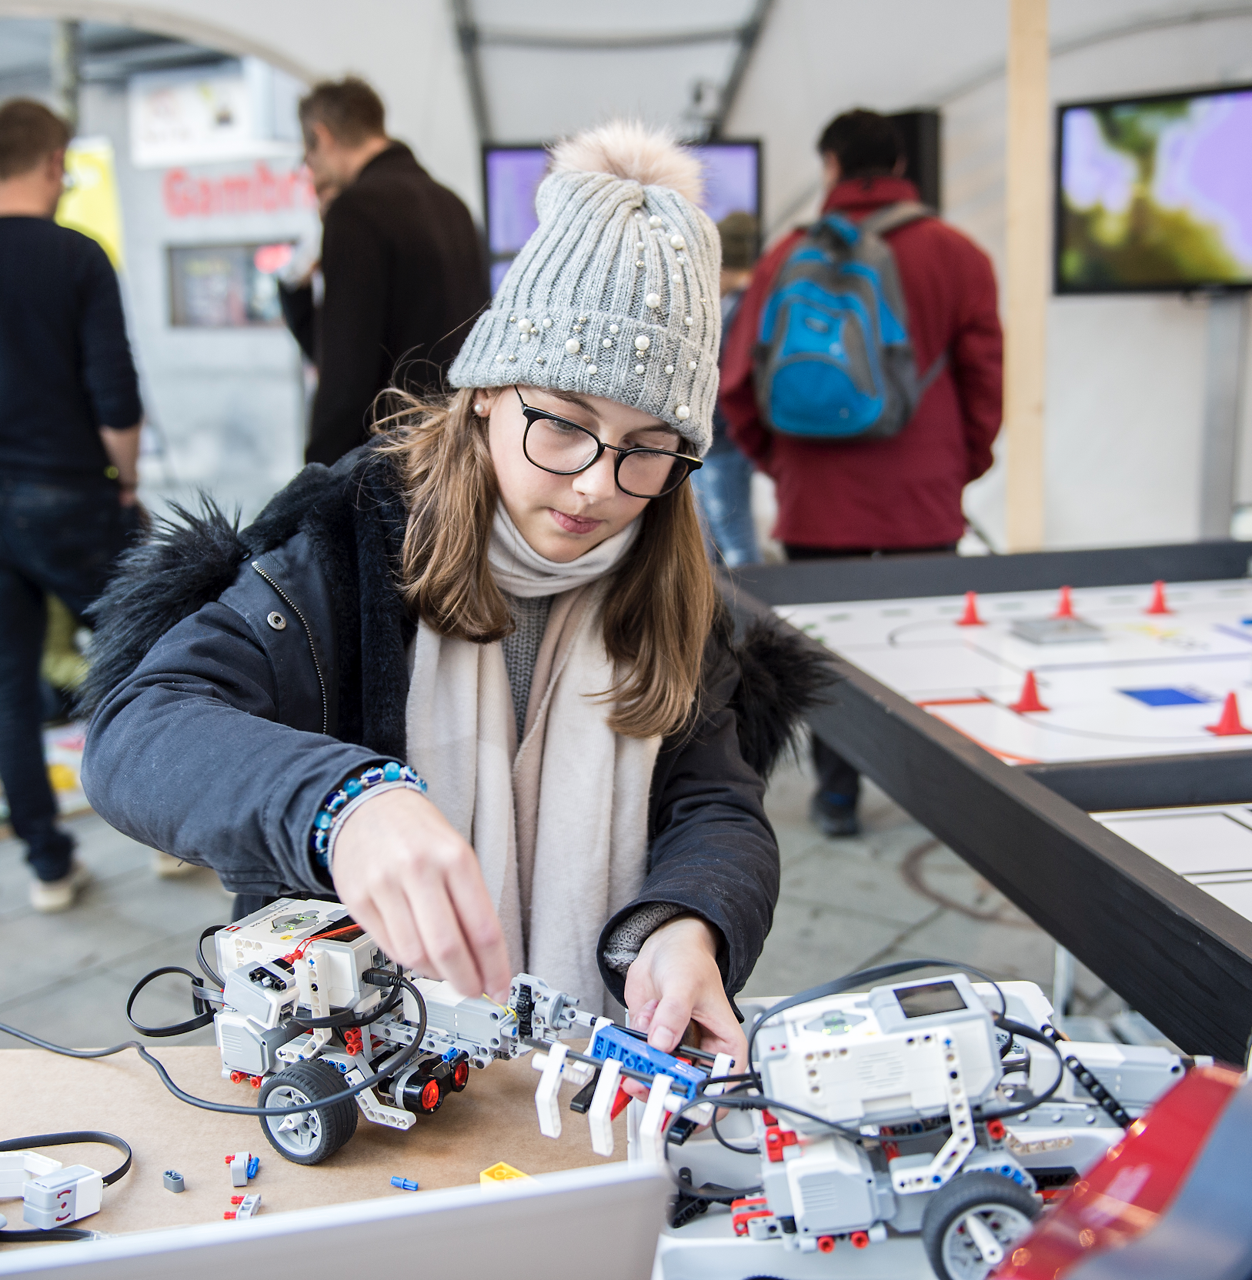
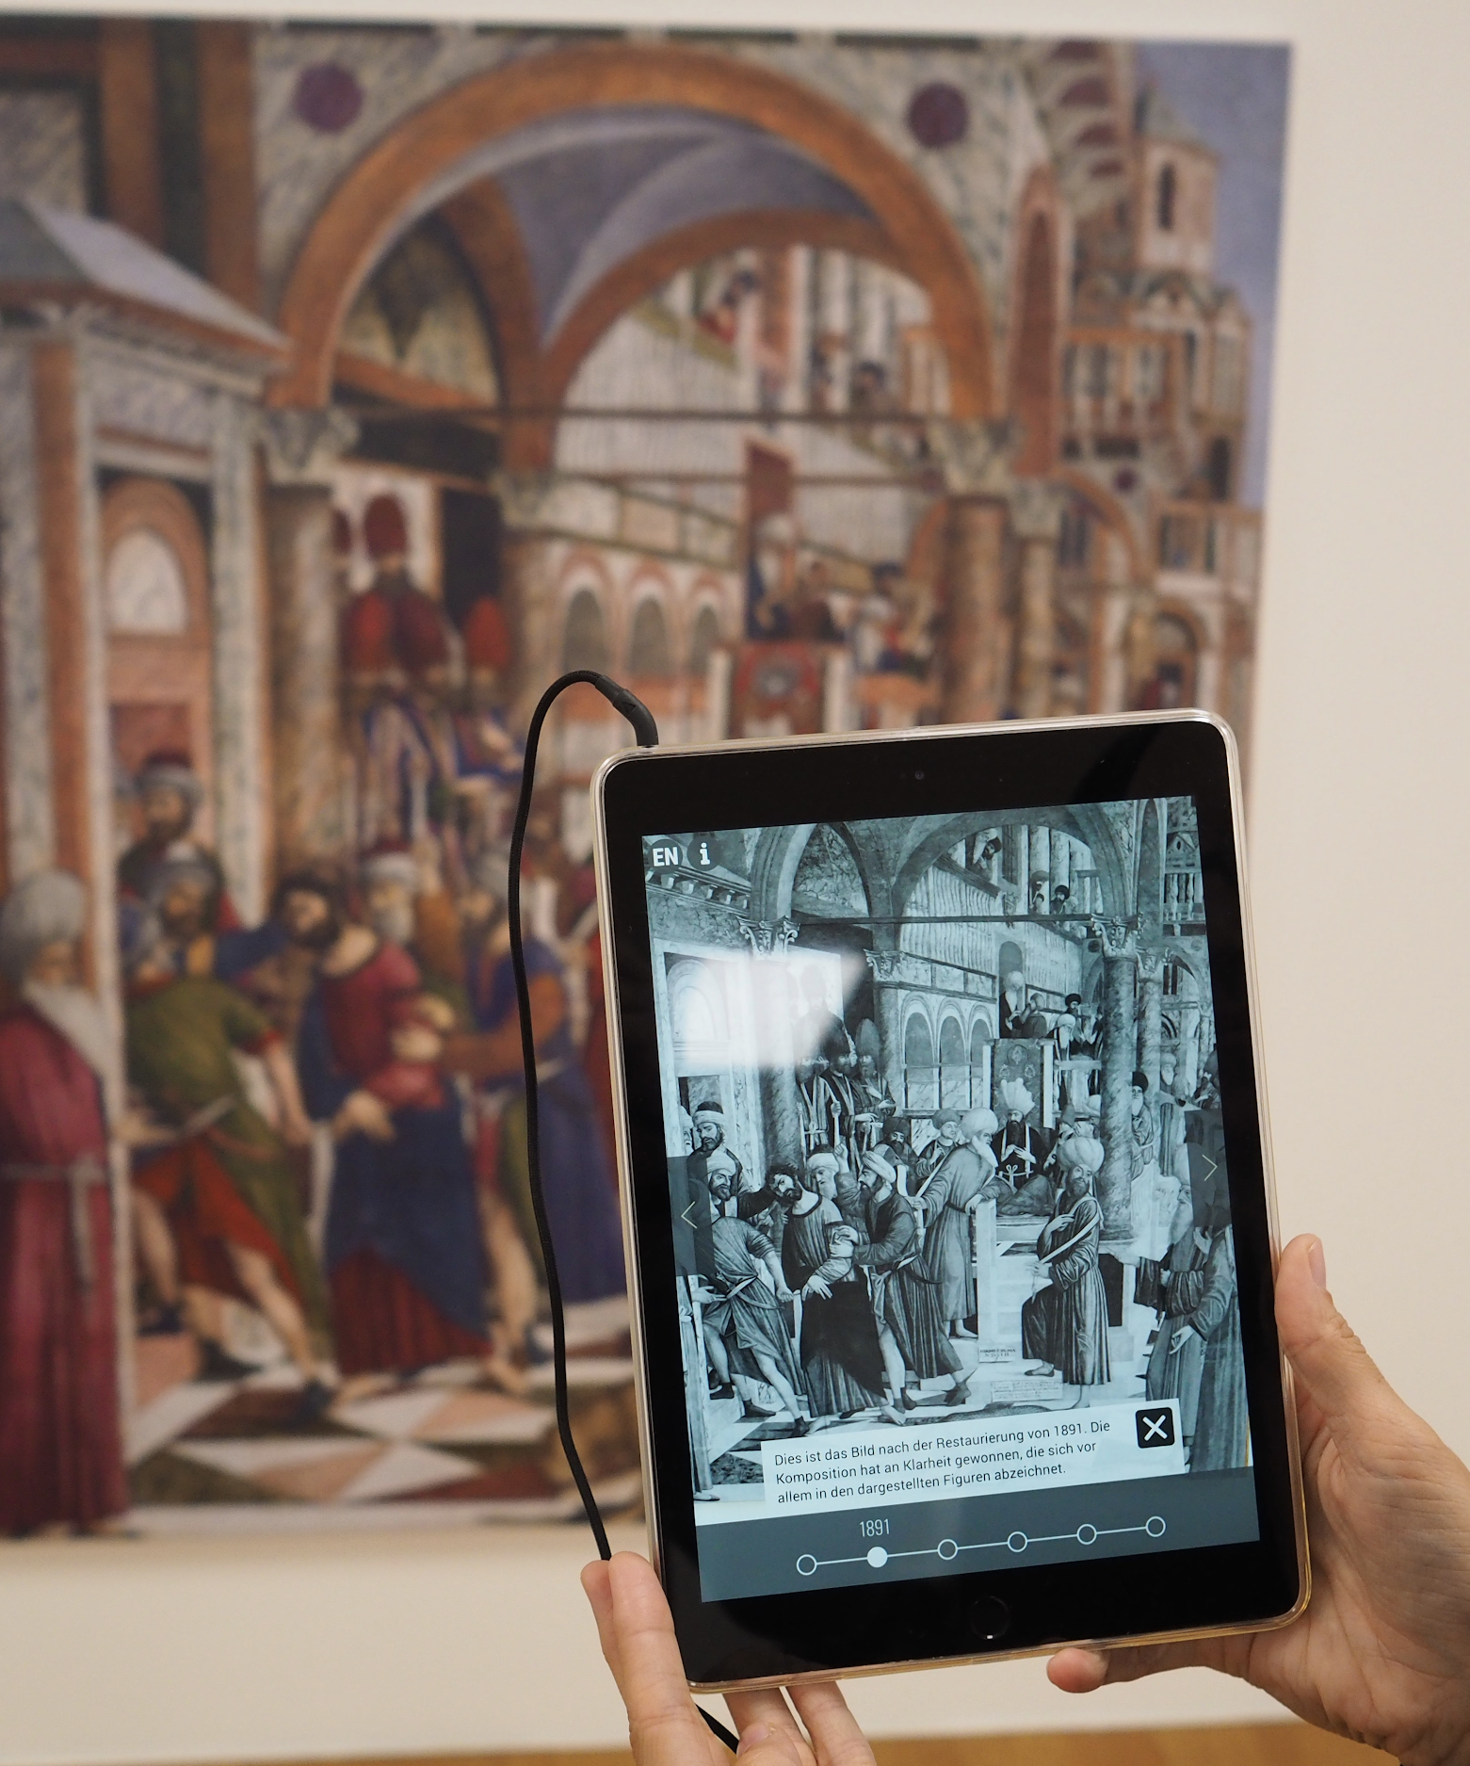
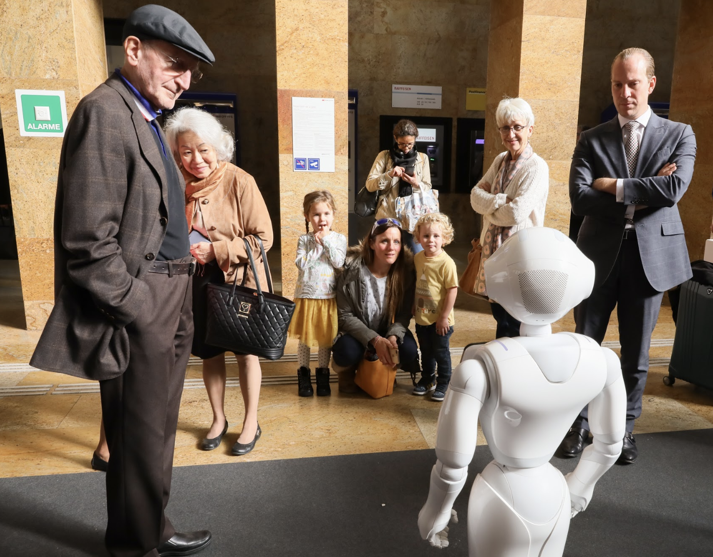
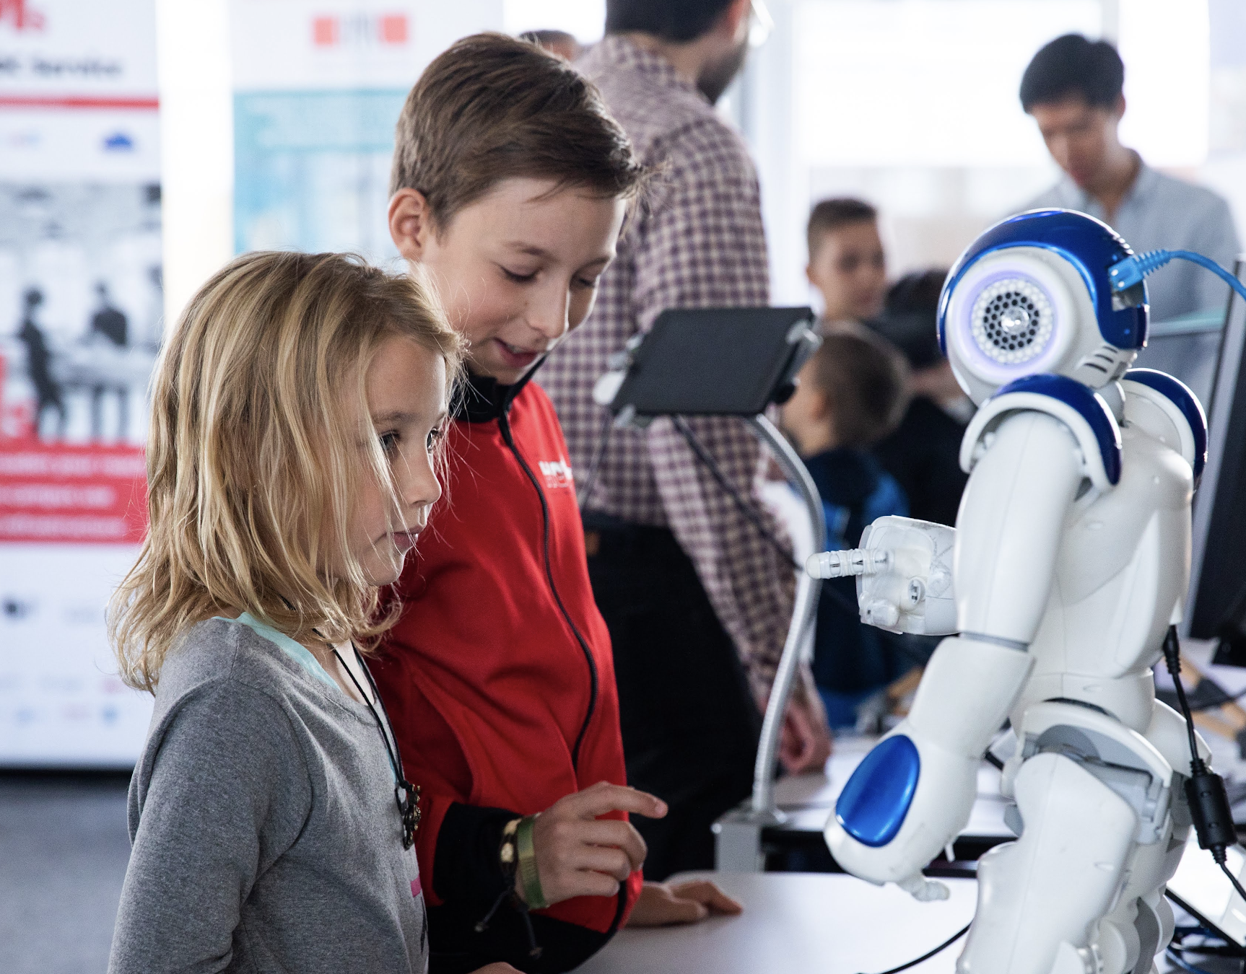
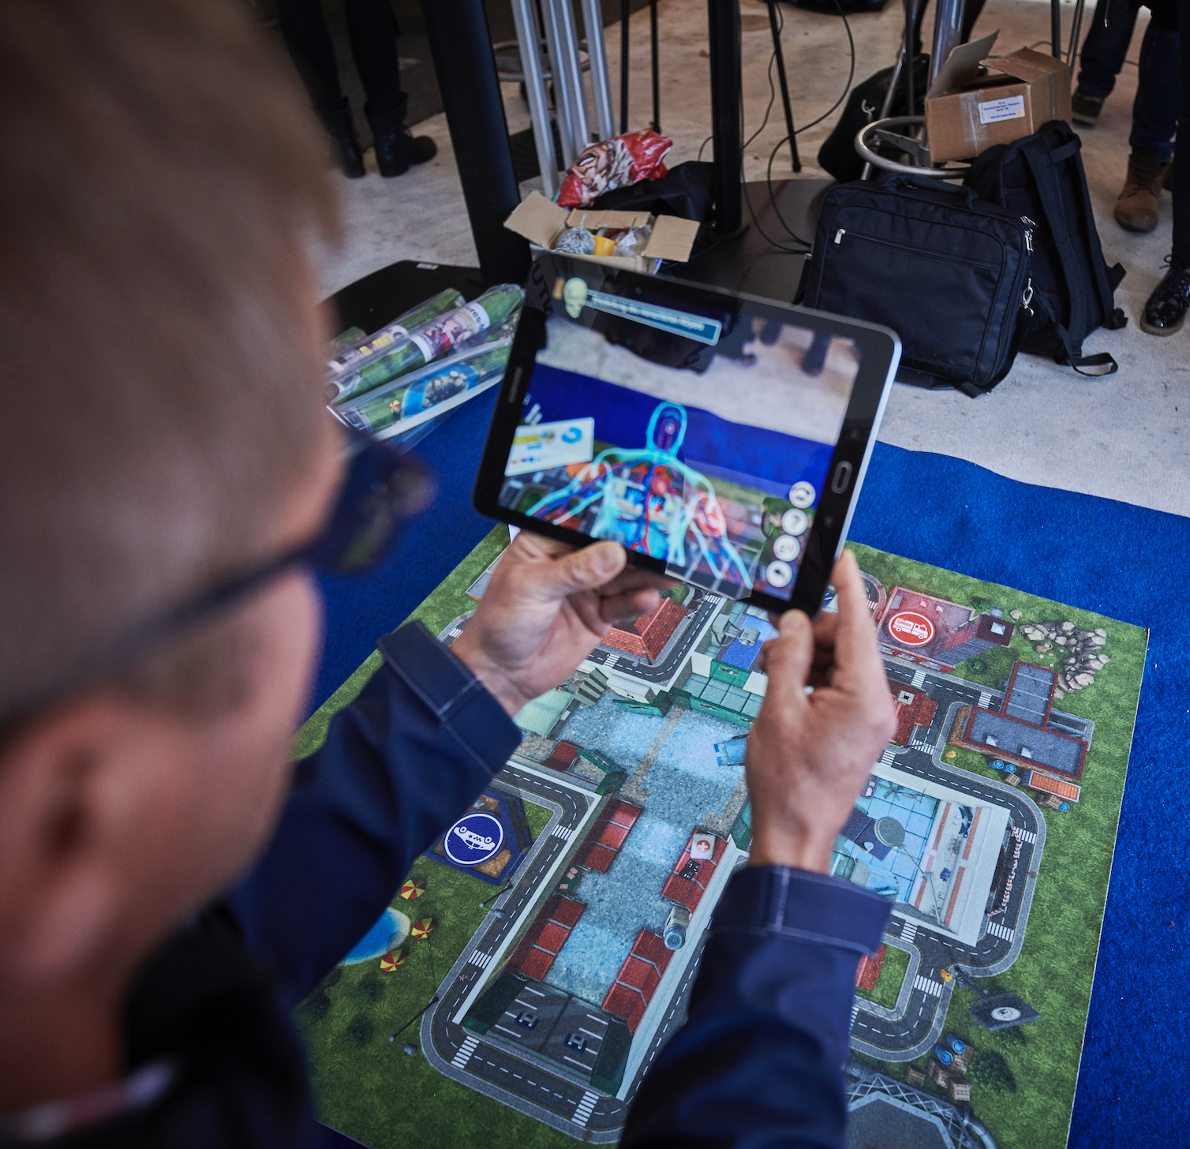
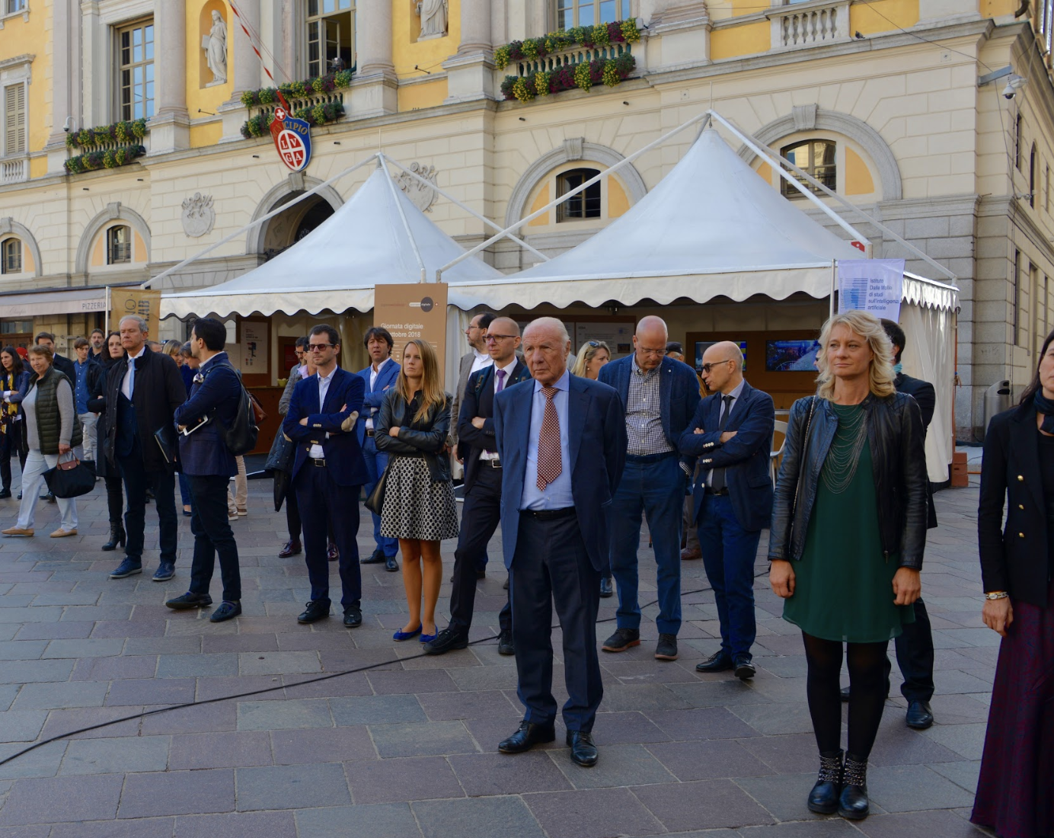

Slide 16

Digital Day: 25 October 2018
Facts & Figures (1/2)
2 Initiatives launched
2 International delegations on site (and several tweets)
3 Matterhorn projects presented
3 Federal Councillors
3 Press conferences
4 Language regions
4 Premieres (first Swiss eSports Congress, Hegias - first browser
based VR CMS, Staay VR Game, launch Tribo App)
12 + Cities with activities
30 + involved Startups
40 + SME’s
72 + Partners (+65%)
200 + Activities free of charge
600 + Kids at ETH/EPFL programming workshops
and much more
up to
250‘000
People reached onsite
+ 25%
Visitors
significant increase in visitor engagement and time spent on site
+
+
diversity of stakeholders (schools, minorities etc)
Notes:
ESports Kongress
Staay
Hegias
ICRC
Tribo

Slide 17
Challenges – collaboration only!
18 working groups including more than 70 companies
With the challenge, digitalswitzerland enables interdisciplinary and cross-sector teams to implement their innovative ambitions within a competitive framework.
We frame these ambitions as bets because for Switzerland’s future we want to go all in. As Switzerland has always excelled in collaboration and innovation to overcome challenges, we are confident to win also these bets.
The ambitious program puts Switzerland, its companies, the local academia and politics at the heart of digitalization.

Slide 18
Challenges – collaboration only!
18 working groups including more than 70 companies

Slide 19
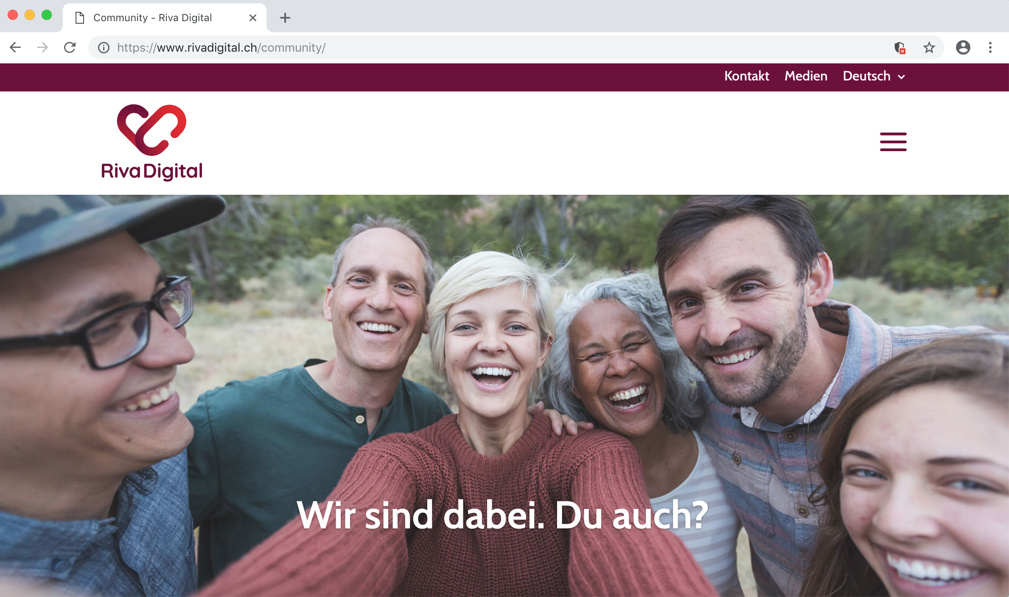
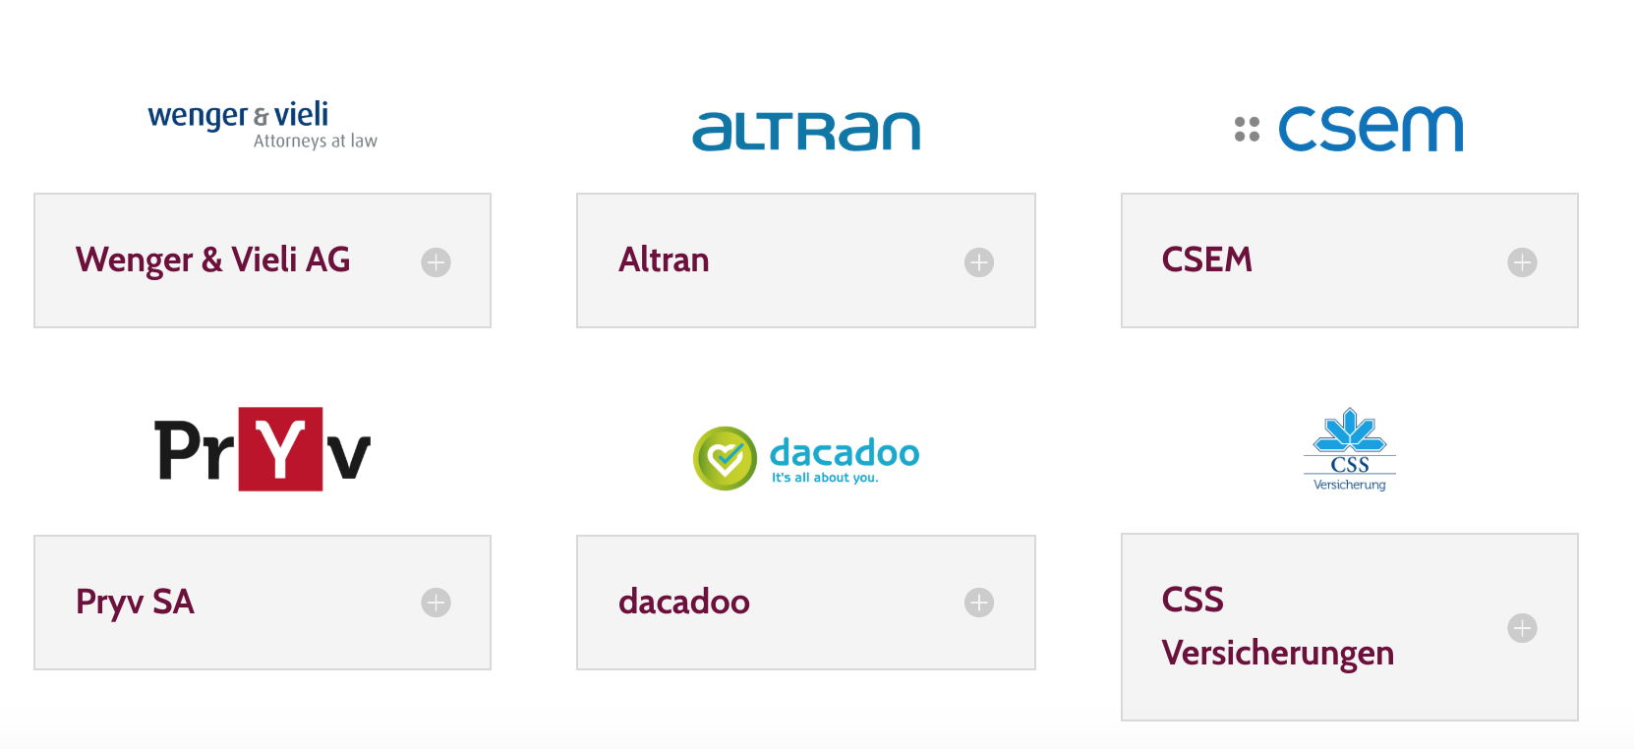
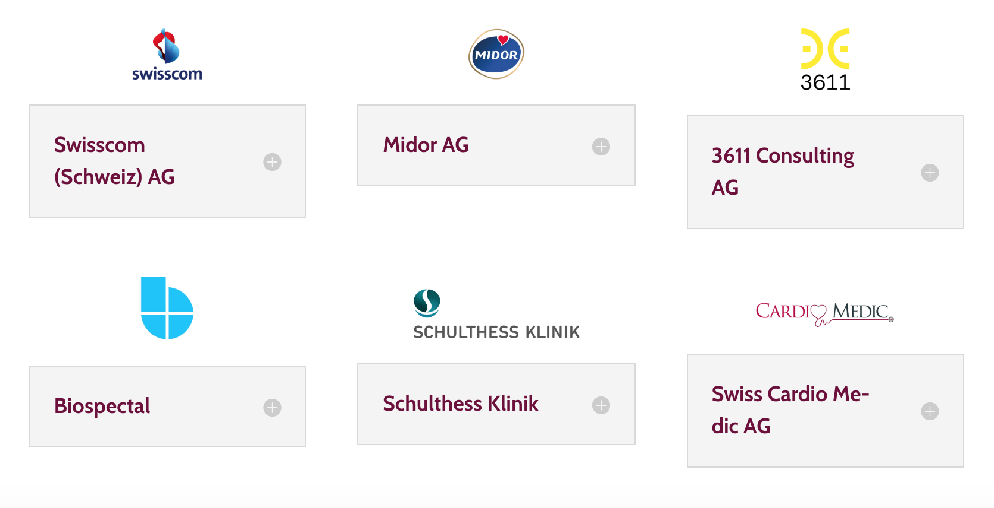
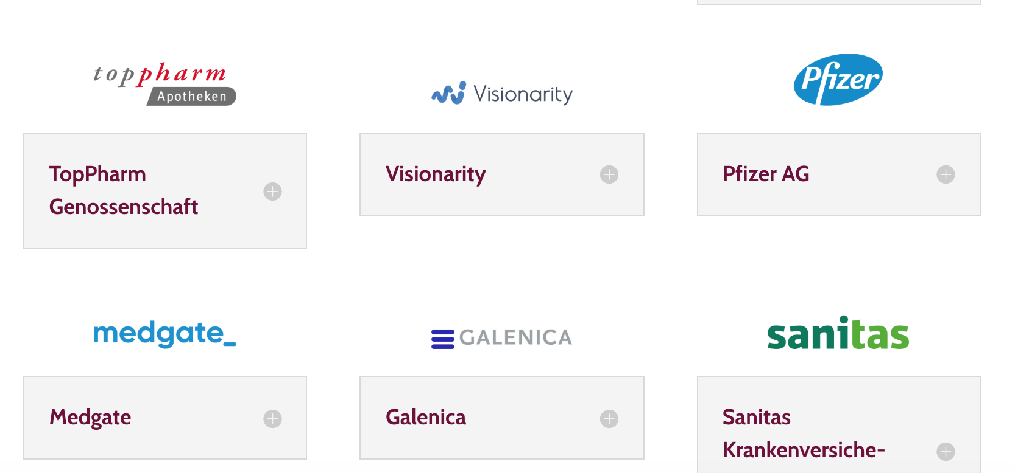
A great collaboration model: Riva Digital

Slide 20


THANK YOU!

